Slide 1

SSID: zenguest
Password: password
Notes:
Please remove this slide when sharing the document to the public

Slide 2
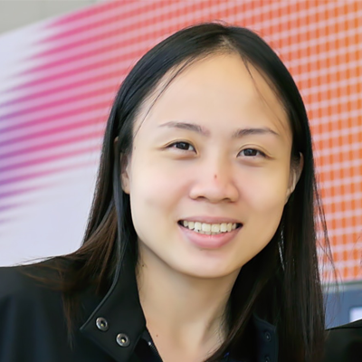
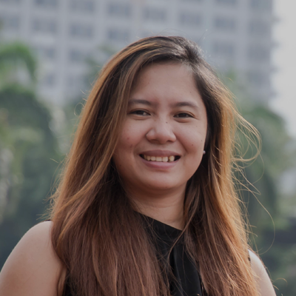
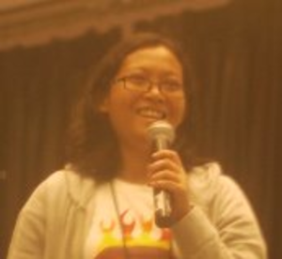
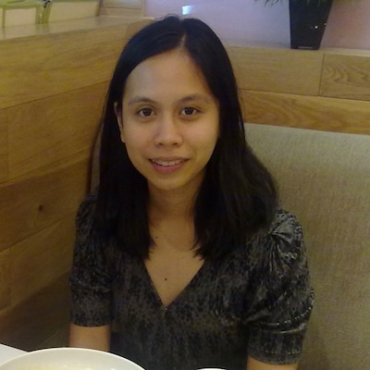
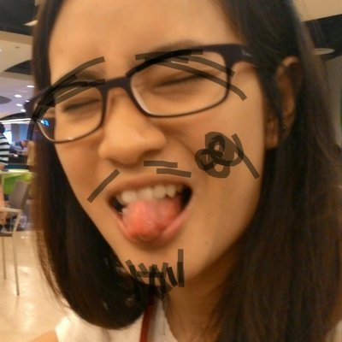
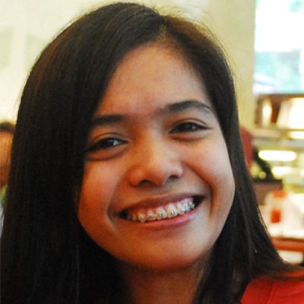

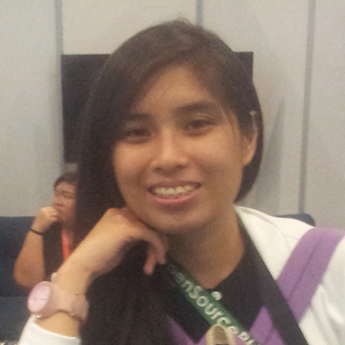
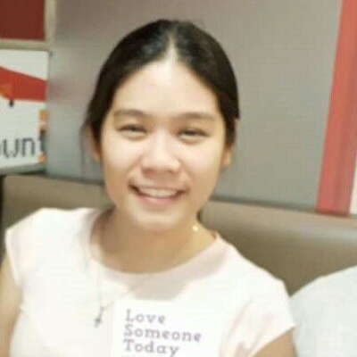

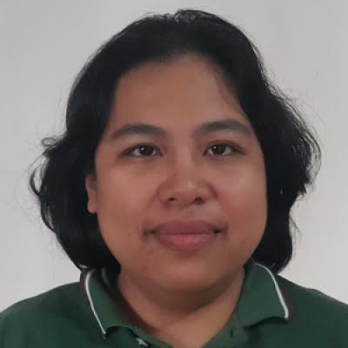
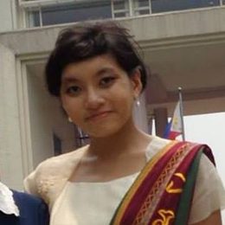
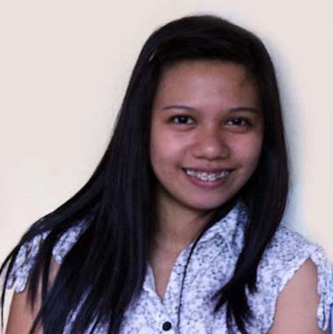
Artificial Intelligence Study Group
Twitter: @wwcodemanila
FB: fb.com/wwcodemanila
#WWCodeManila
#AI
#StudyGroup

Slide 3
Issa Tingzon
Research Fellow
PCARI
Notes:
Please use only the three colors for the content.

Slide 4
New Member’s Introduction

Slide 5

I am <name>
<your current profession>
<why did you join this study group?>
Notes:
Please use only the three colors for the content.

Slide 6
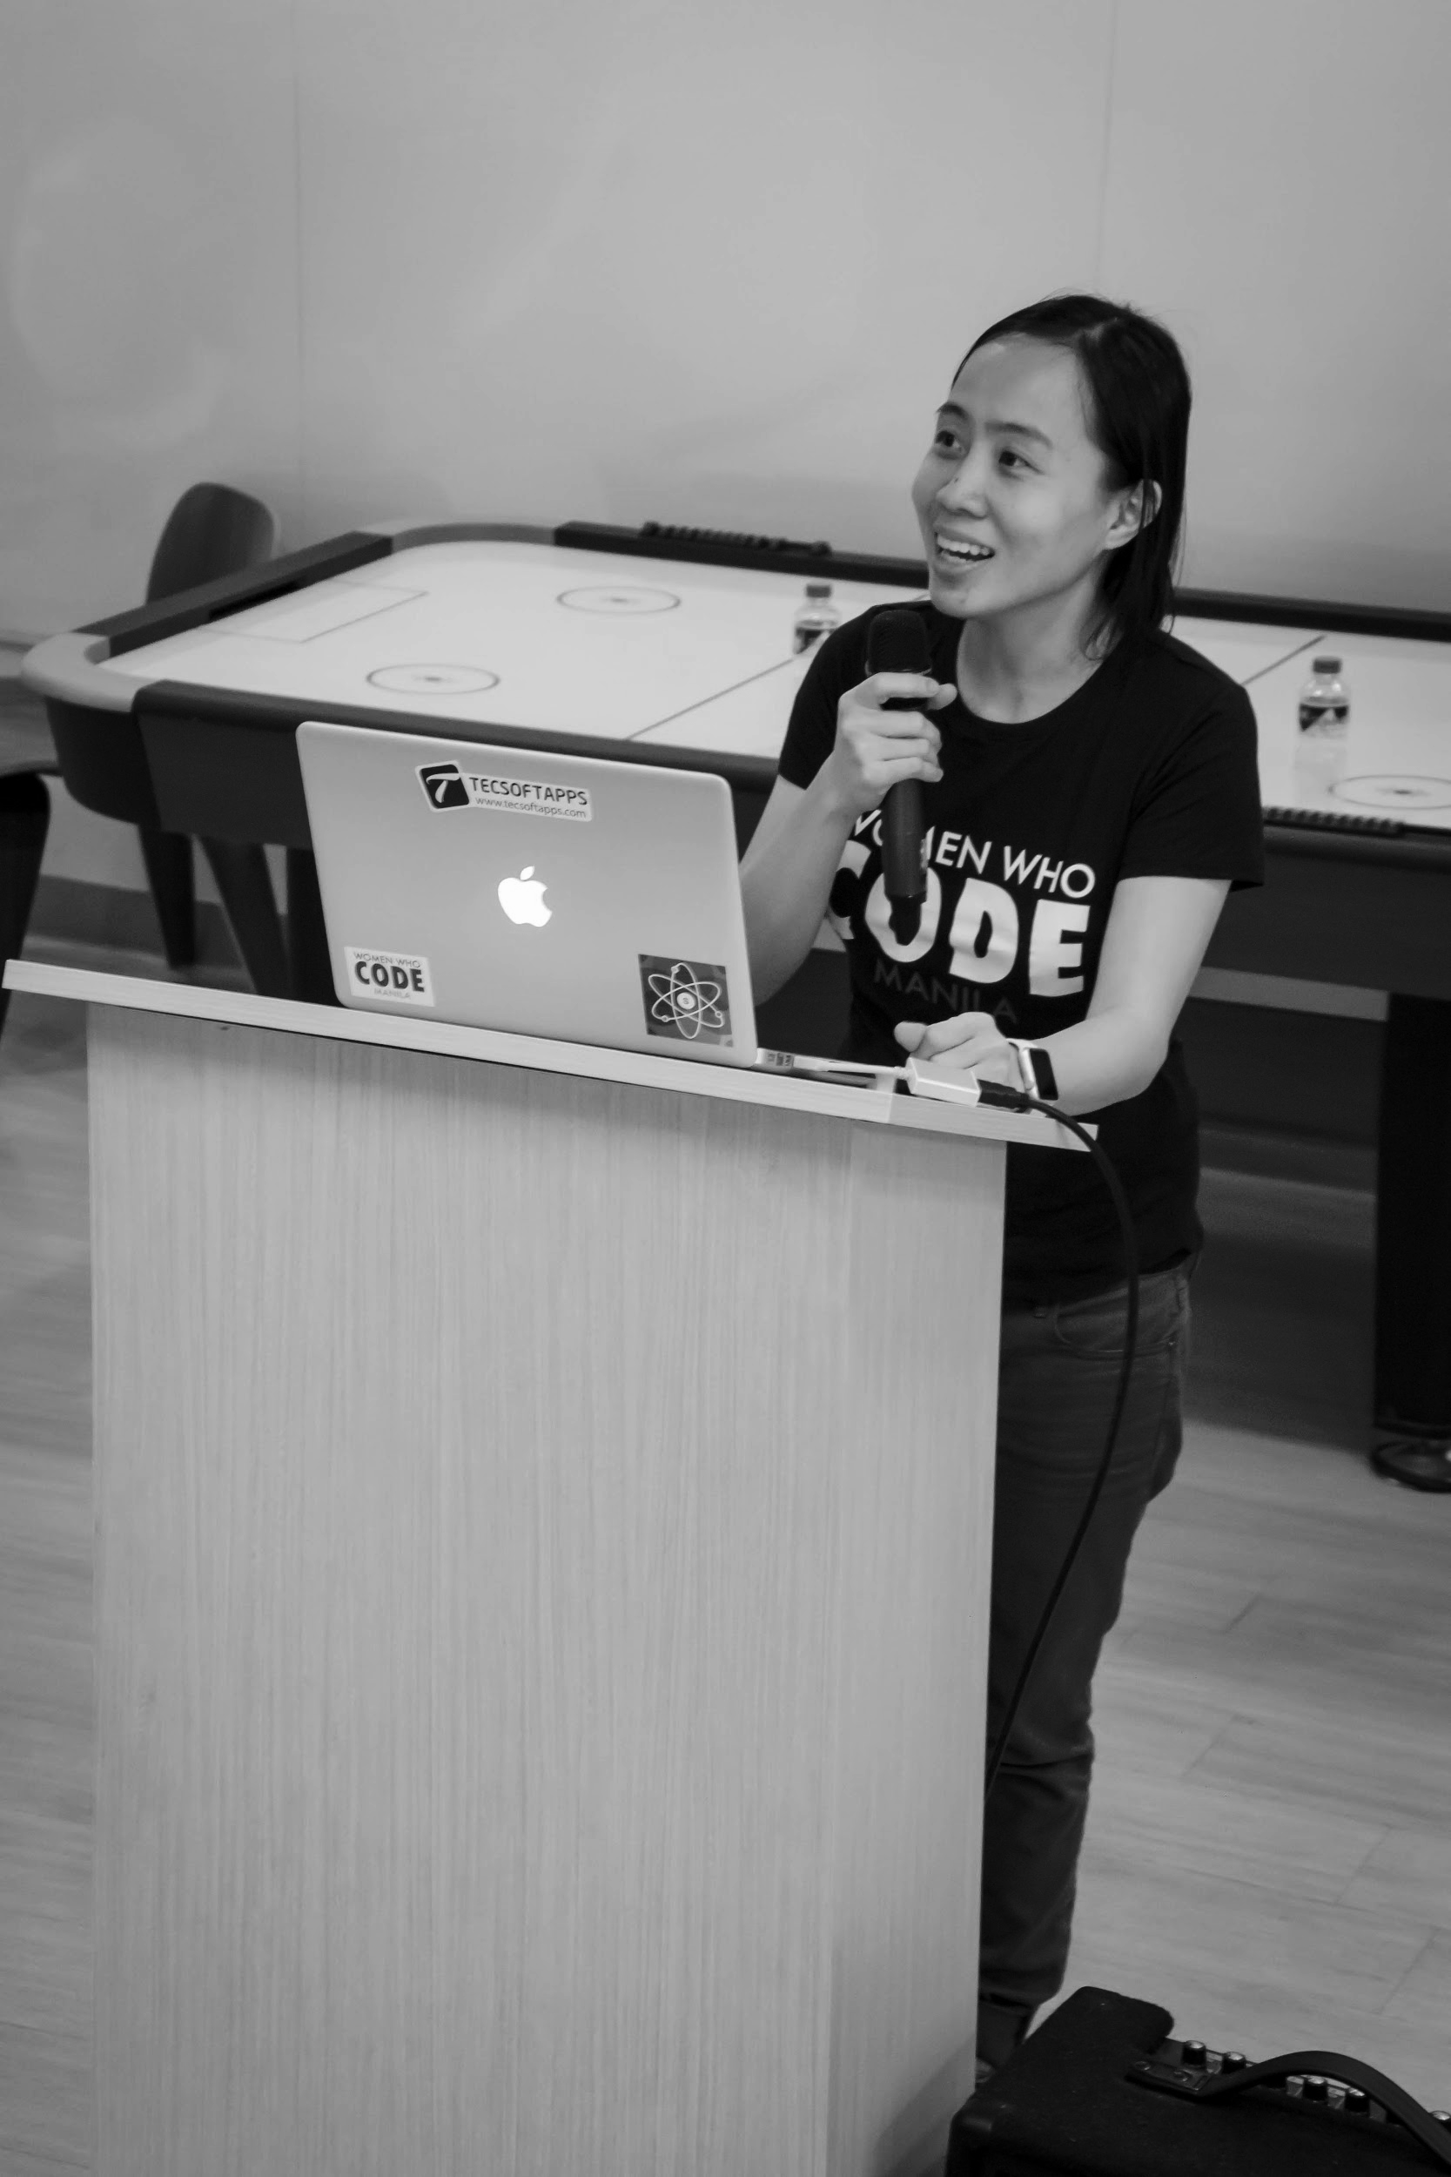
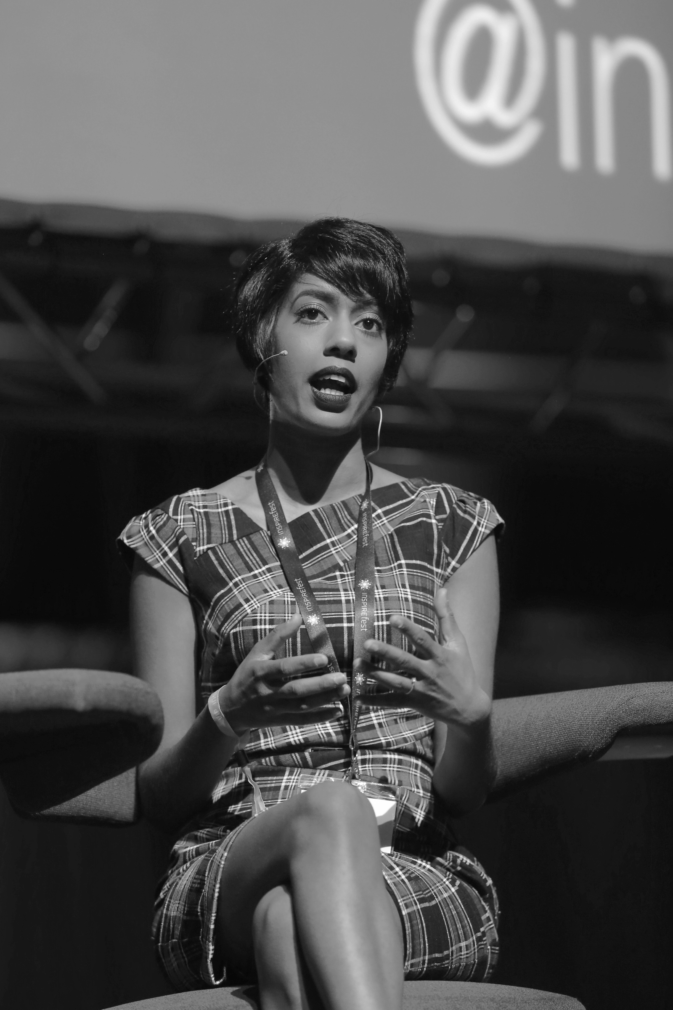
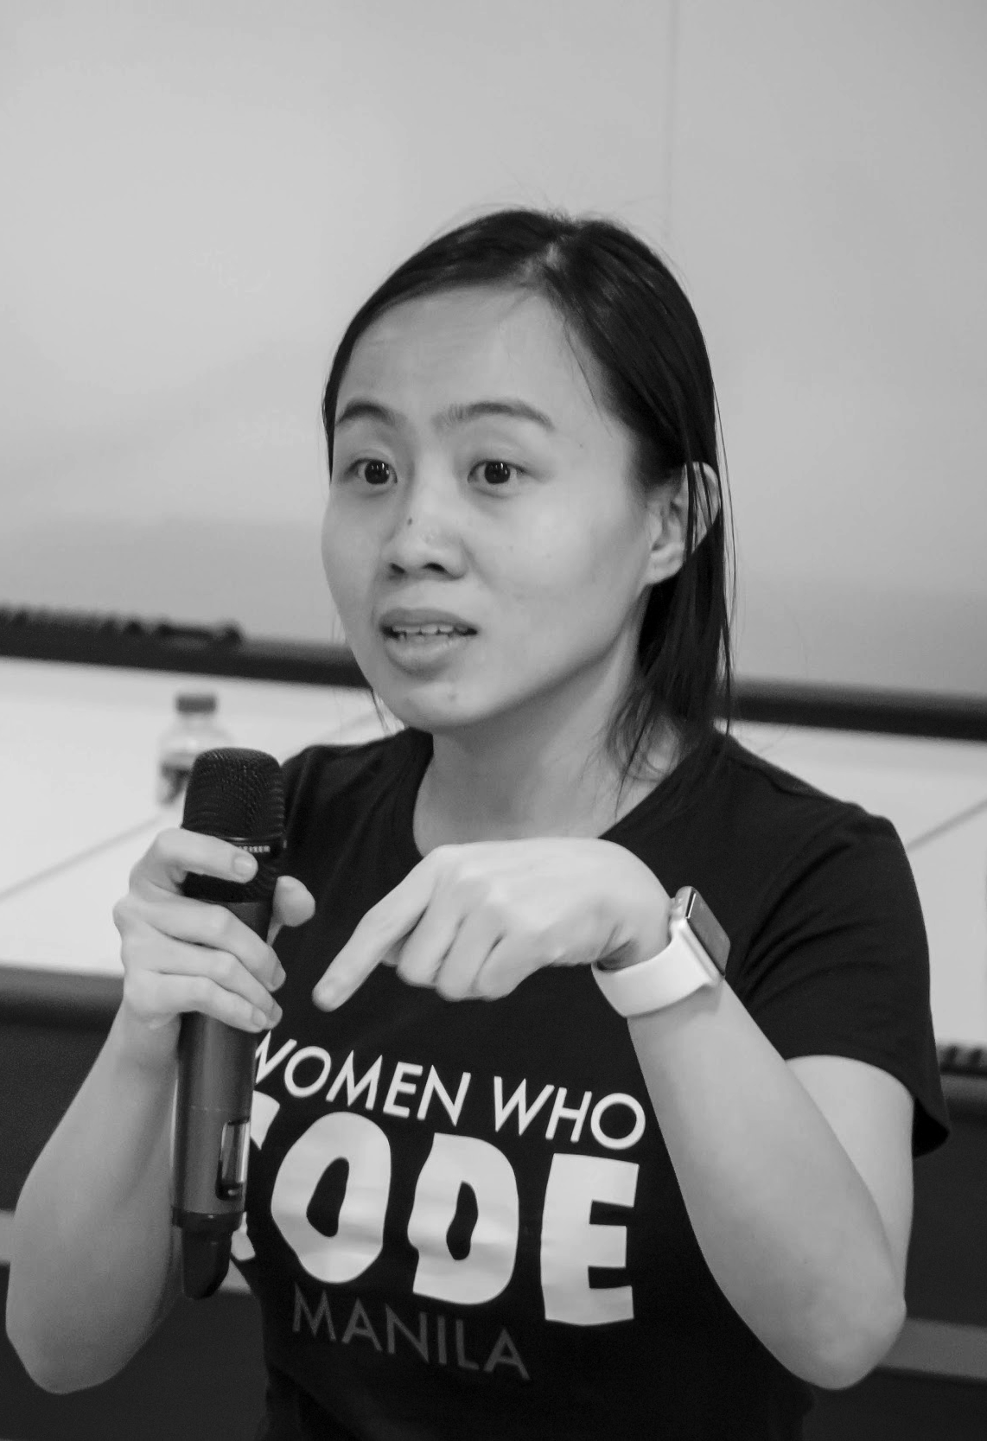
OUR MISSION
Inspiring women to excel in technology careers.

Slide 7
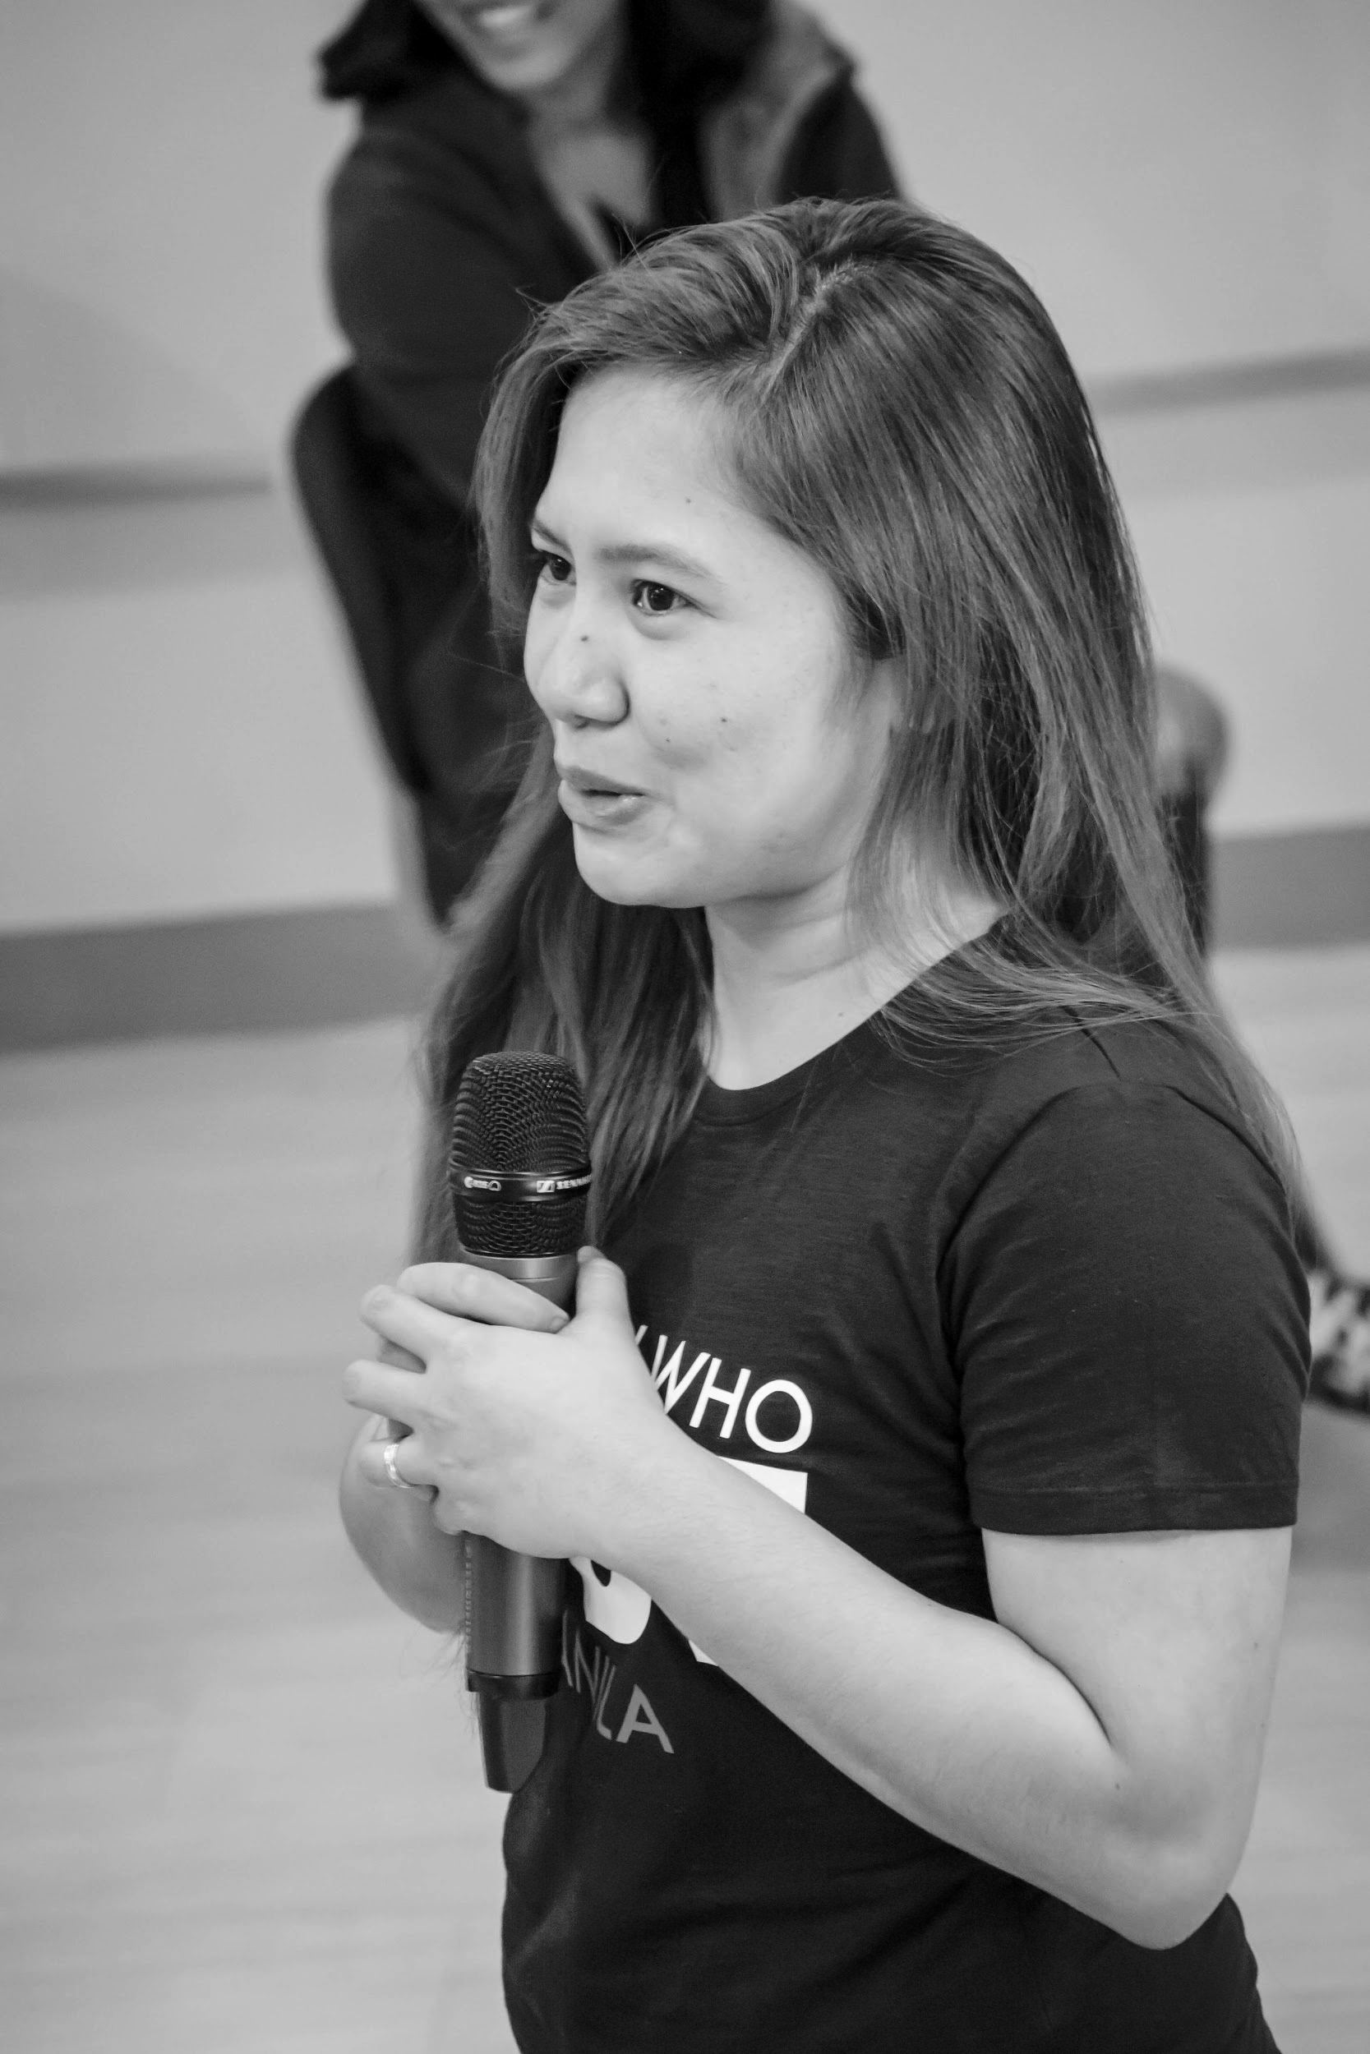
OUR VISION
A world where women are representative as technical executives, founders, VCs, board members and software engineers.

Slide 8
STUDY GROUP
Study groups are events where women can come together and help each other learn and understand a specific programming language, technology, or anything related to coding or engineering.

Slide 9
GUIDELINES
If you have a question, just ask
If you have an idea, share it
Make friends and learn from your study groupmates
Do not recruit or promote your business

Slide 10
SHOW & TELL
Notes:
Please use only the three colors for the content.

Slide 11
DECISION TREES
TOPIC FOR TODAY

Slide 12
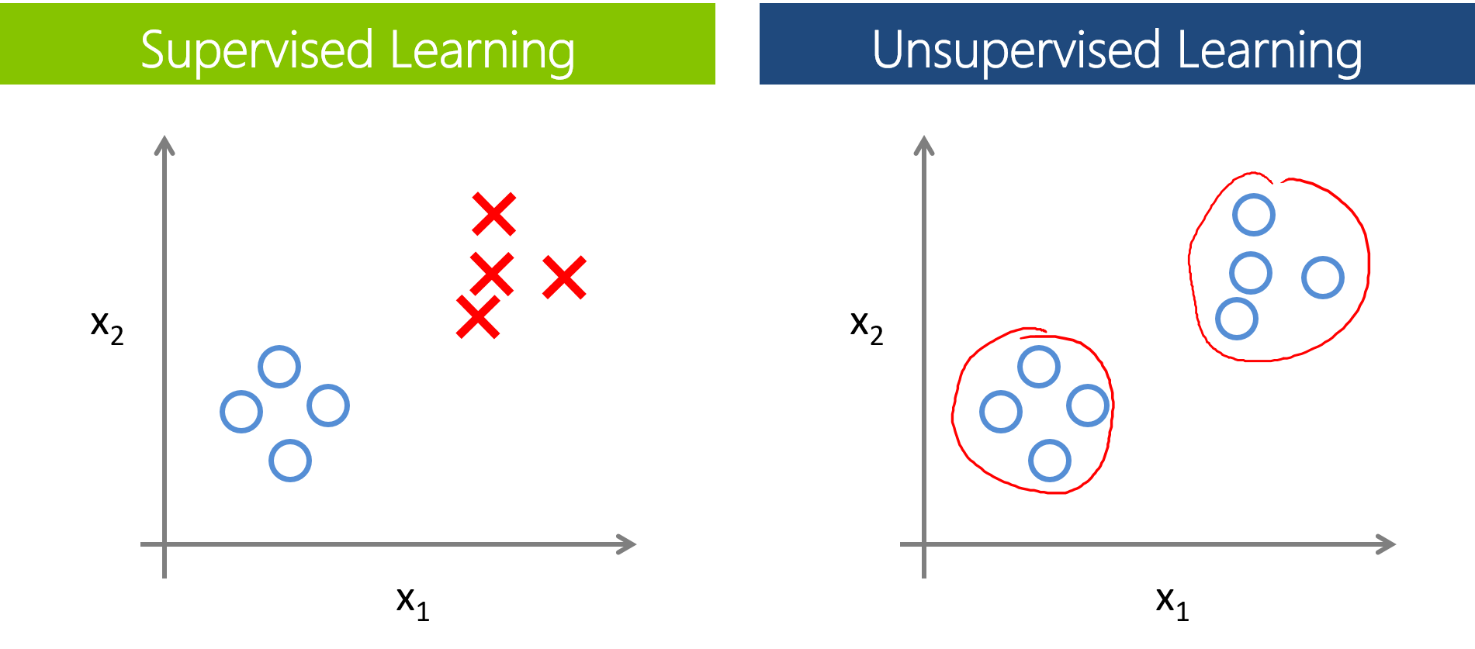
REVIEW
Two types of ML Algorithms:
Supervised
Data is labelled
Goal: Predict or classify data
Unsupervised
Data is unlabelled
Goal: Uncover patterns or structure in data

Slide 13
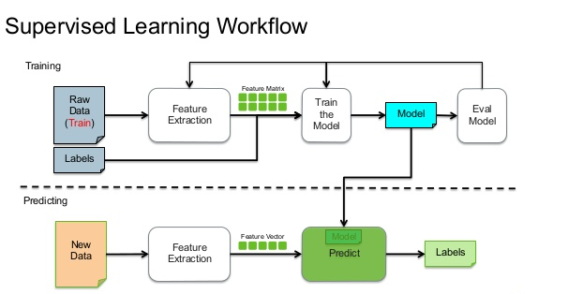
Supervised Learning Workflow

Slide 14
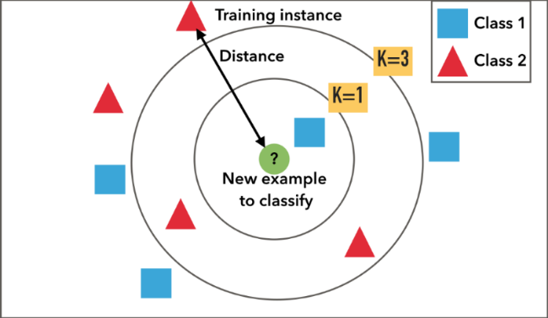
REVIEW: K-Nearest Neighbors (KNN)

Slide 15
DECISION TREES
A type of supervised learning algorithm
Interpretable; mimics human decision making

Slide 16

If Salary > $50,000 and commute is not more than 1 hour and offers free coffee, then accept offer!

Slide 17
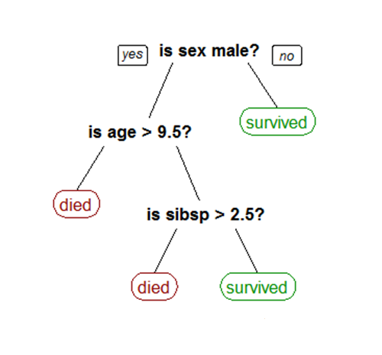
Would you survive the sinking of the Titanic?

Slide 18
TERMINOLOGY
Root Node: represents the entire training set
Splitting: process of dividing a node into two or more subsets/nodes
Internal/Decision Node: corresponds to an attribute
Leaf/Terminal Node: corresponds to a class label

Slide 19
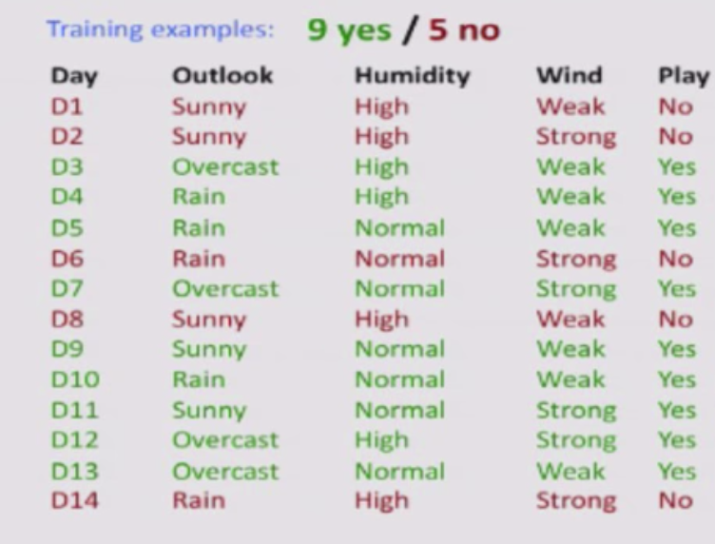
Predict if John will play tennis

Slide 20
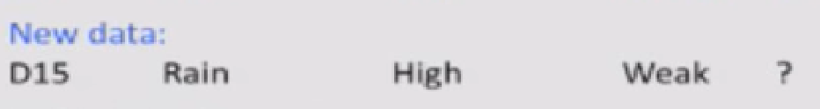
Predict if John will play tennis

Slide 21
Predict if John will play tennis
Hard to guess
Try to understand when John plays tennis

Slide 22
Predict if John will play tennis
Divide and Conquer
Split into subsets
Are they all “pure”?
If yes: stop
If not: repeat
See which subset new data falls into

Slide 23
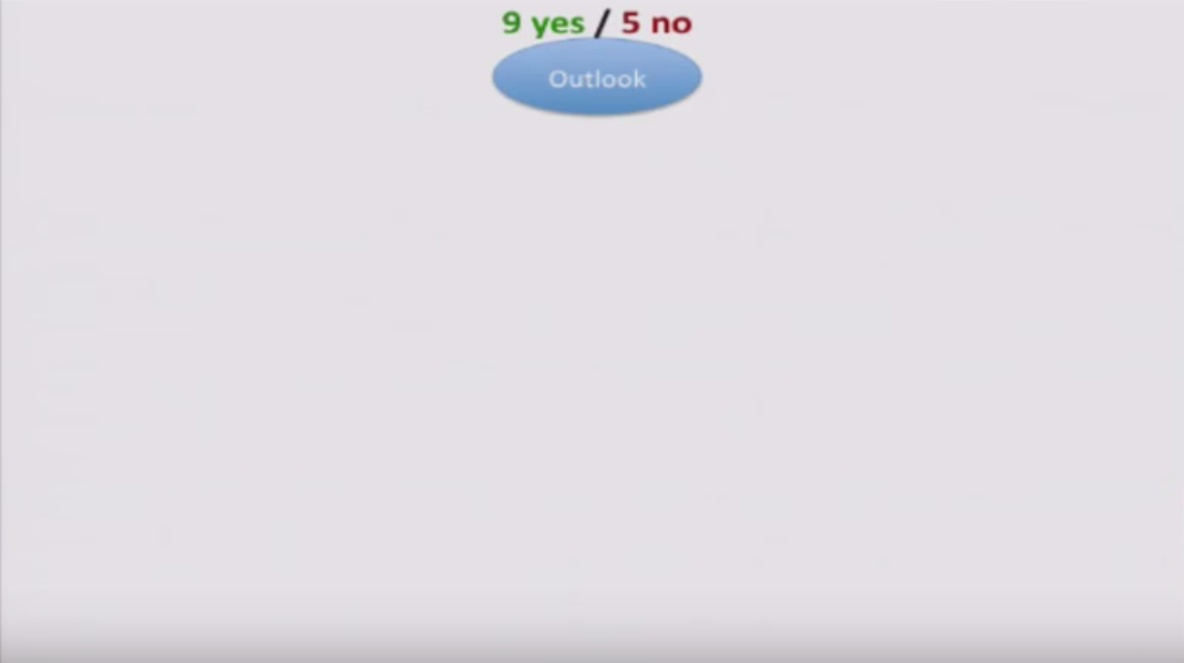

Slide 24
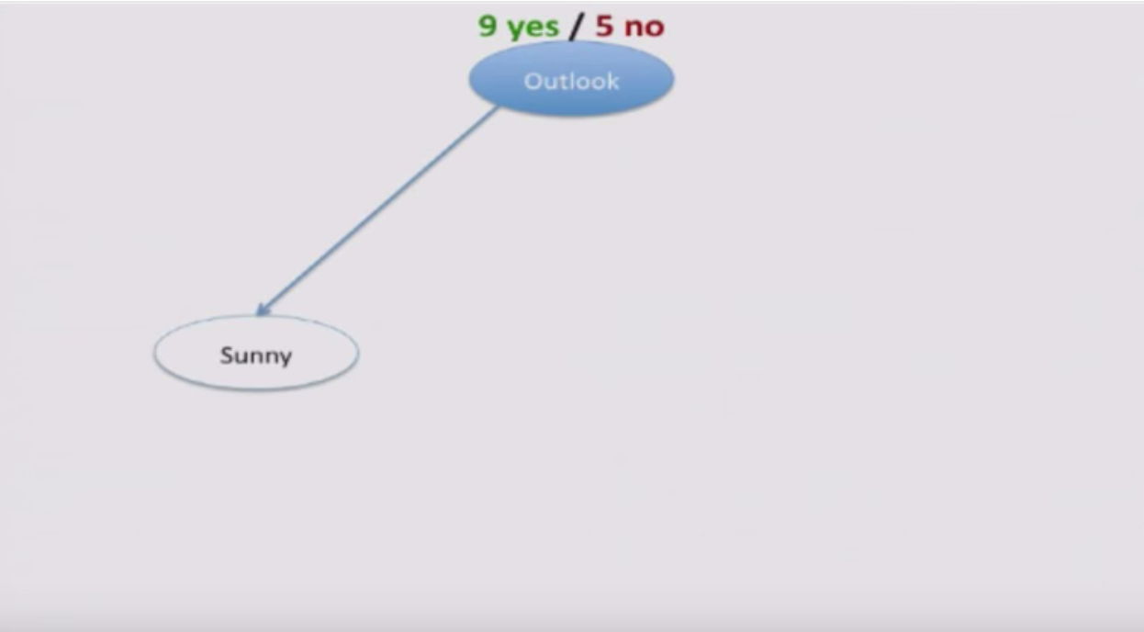

Slide 25
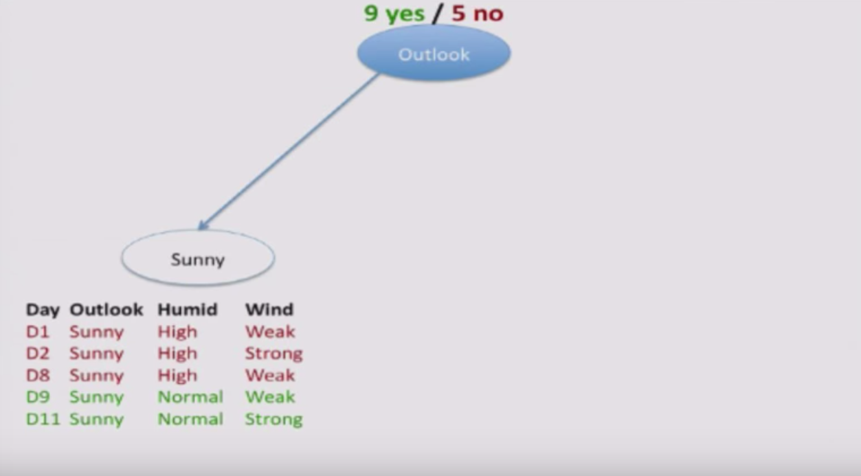

Slide 26
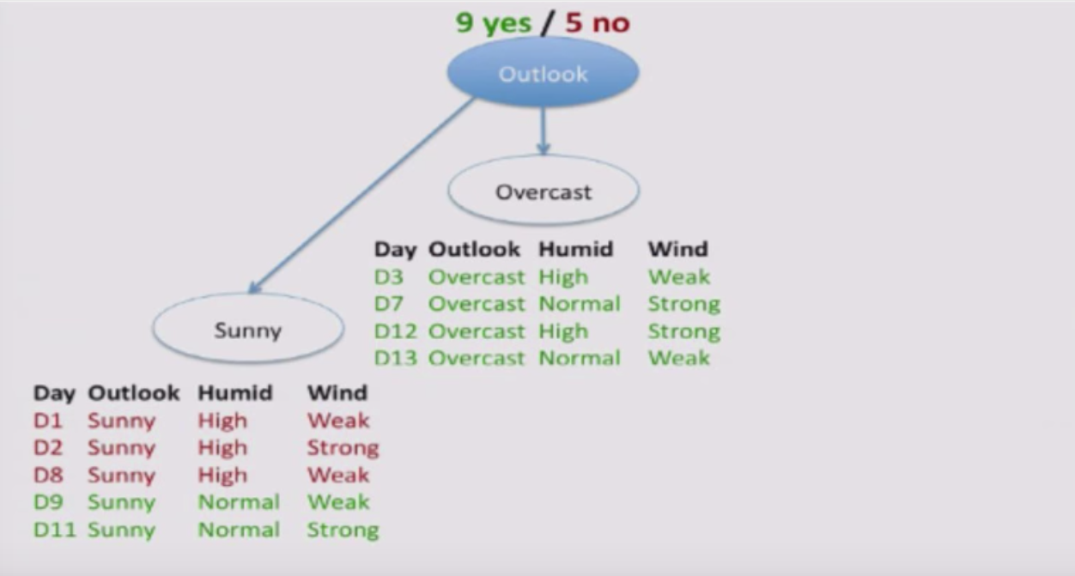

Slide 27
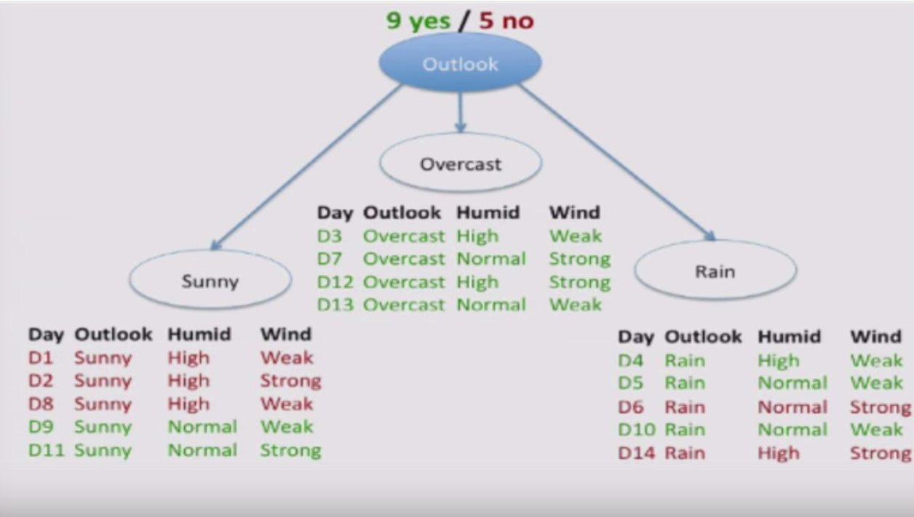

Slide 28
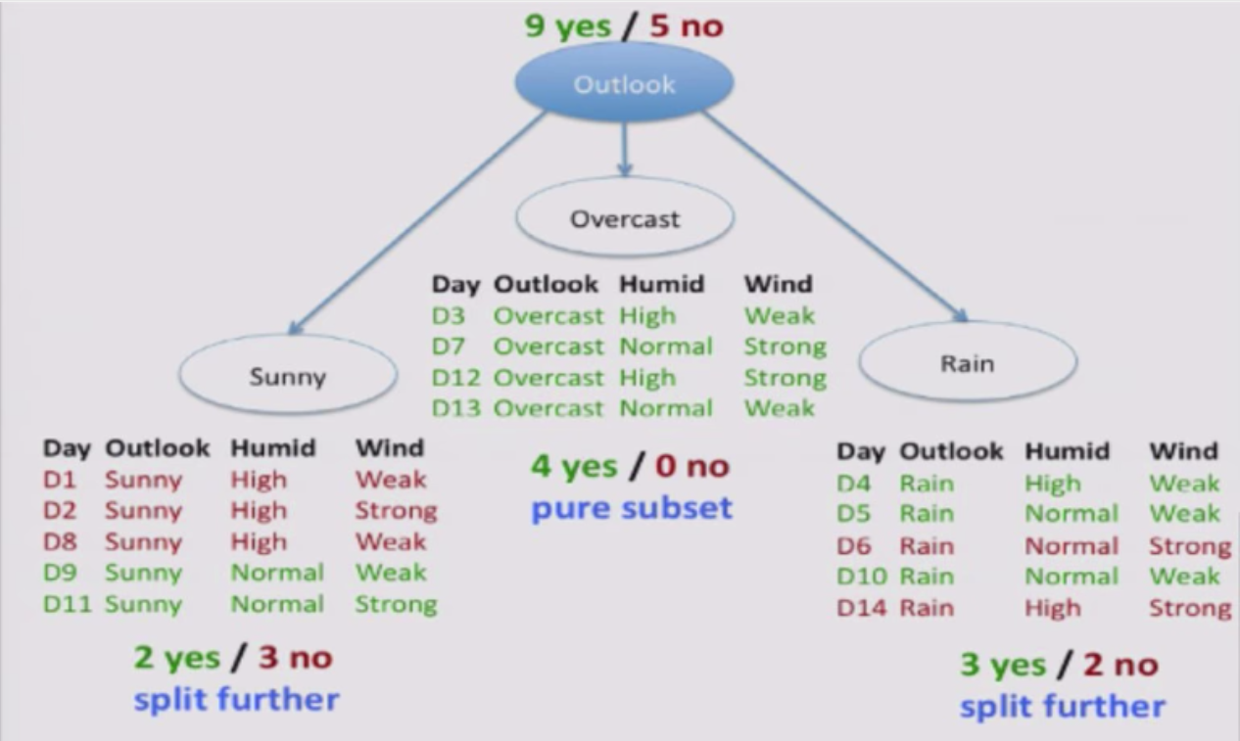

Slide 29
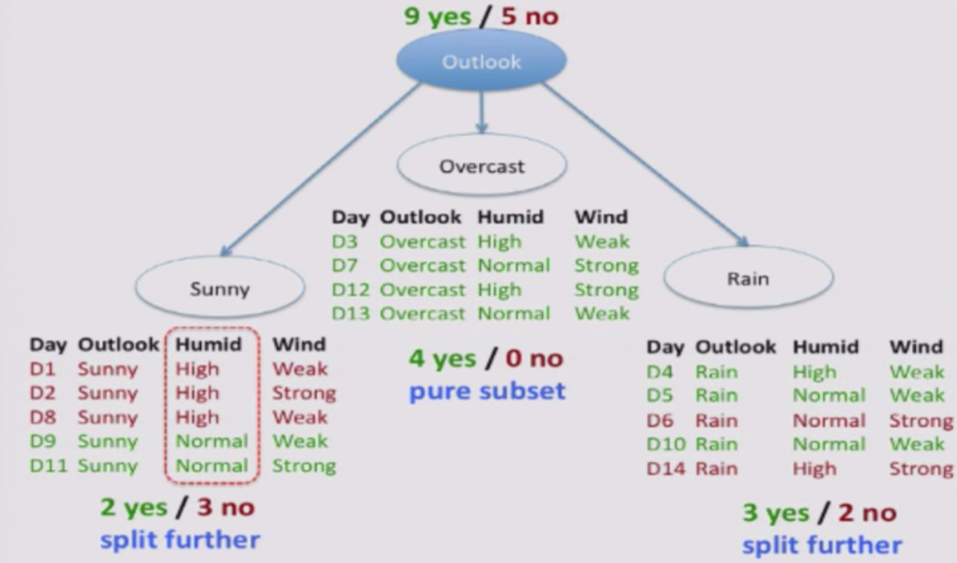

Slide 30
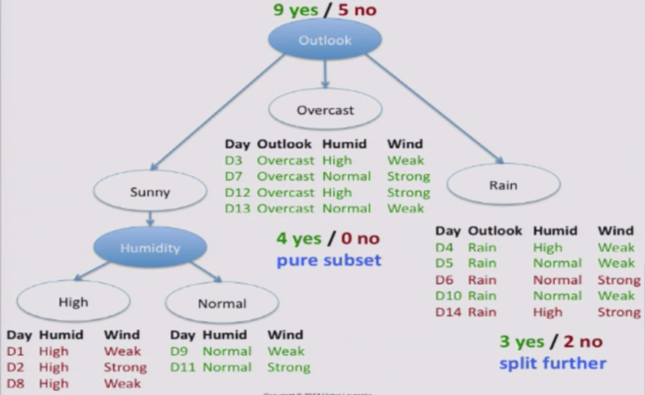

Slide 31
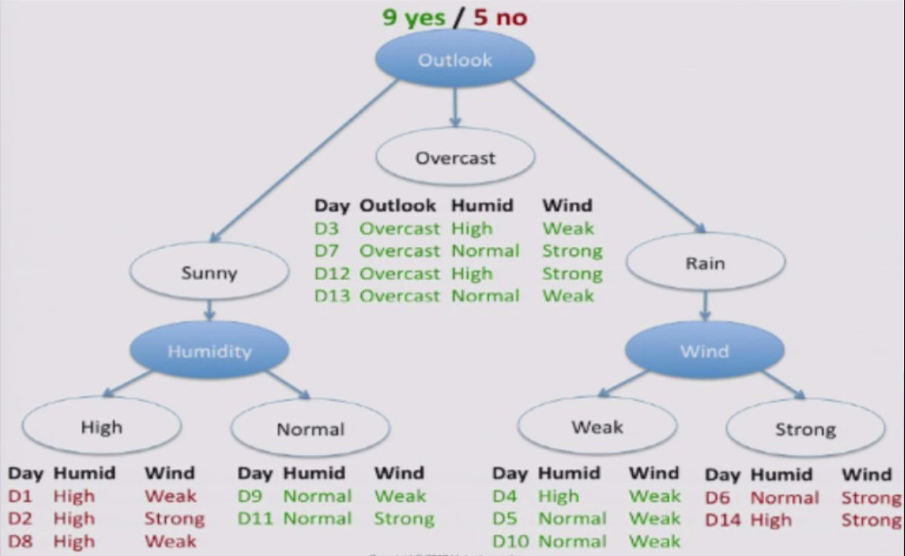

Slide 32
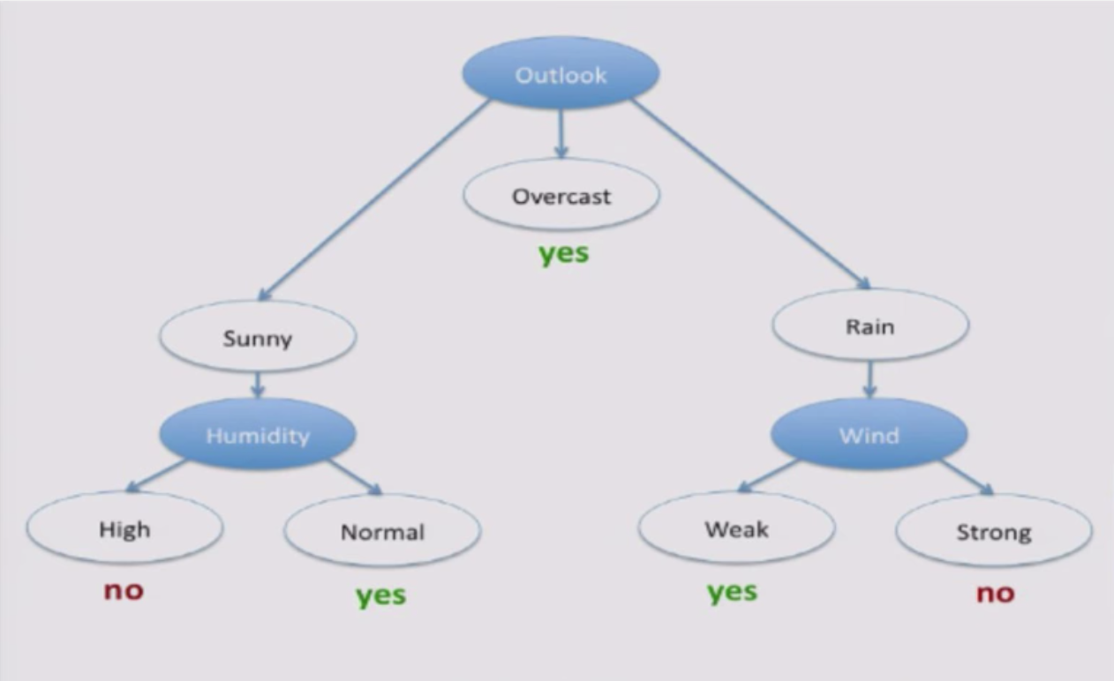

Slide 33
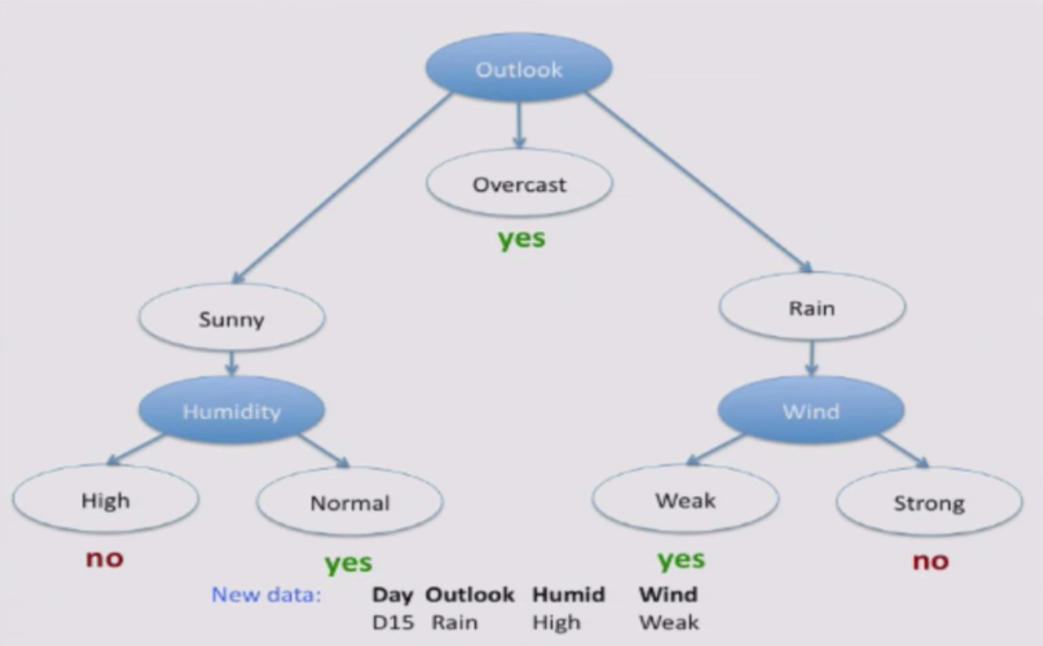

Slide 34
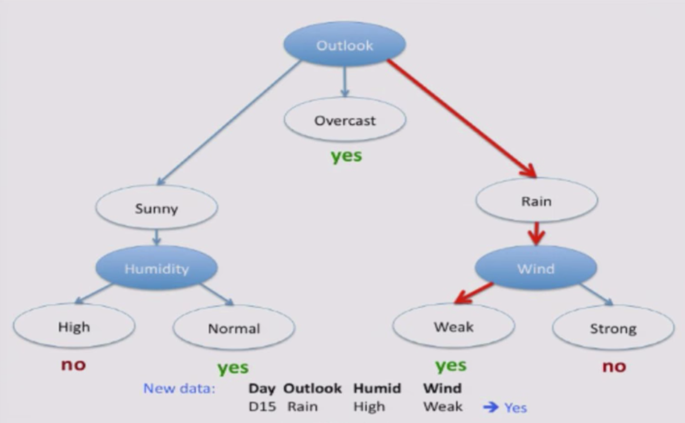

Slide 35


Slide 36
ID3 Algorithm
ID3 - Ross Quinlan, 1986
Suppose feature A is the best attribute to split on.
Split entire training set on attribute A
For each subset/ child node:
If subset is pure: stop
Else: split subset

Slide 37
Which attribute to split on?
Want to measure the “purity” of the split
More certain about Yes/No after the split
Pure set → (4 Yes / 0 No) 100% certain
Impure Set → (3 Yes / 3 No) 50 % certain
Entropy – a way to measure certainty
Higher entropy → more uncertain

Slide 38
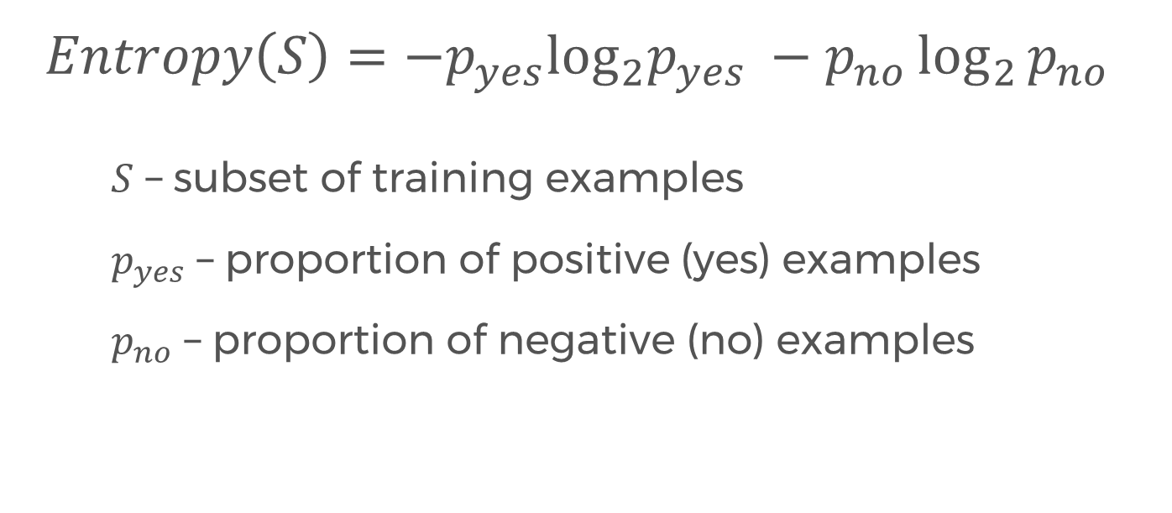
Entropy
$$Entropy\left(S\right)=−p_{yes}\log_{2}p_{yes} −p_{no}\log_{2}{p_{no}}$$
$S$ – subset of training examples
$p_{yes}$ – proportion of positive (yes) examples
$p_{no}$ – proportion of negative (no) examples

Slide 39
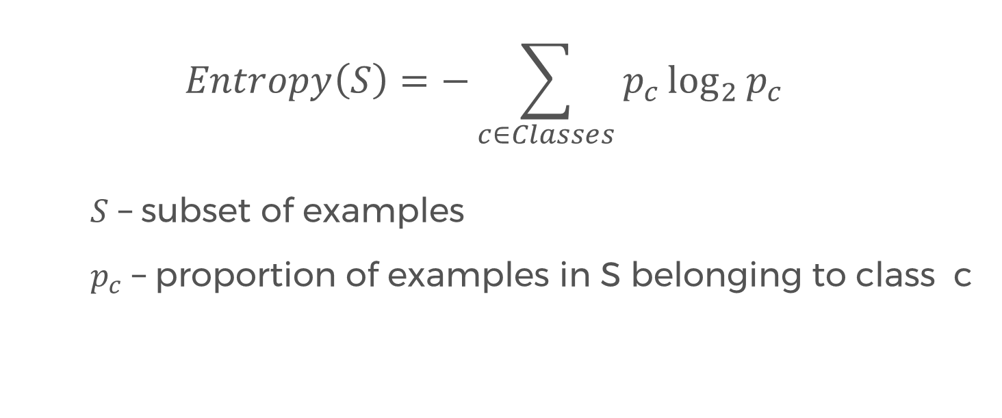
Entropy, more generally
$$Entropy\left(S\right)=−\sum_{c∈Classes}{p_{c}\log_{2}{p_{c}}}$$
$S$ – subset of examples
$p_{c}$ – proportion of examples in S belonging to class c

Slide 40
Entropy example
e.g. (3 yes / 3 no)

Slide 41
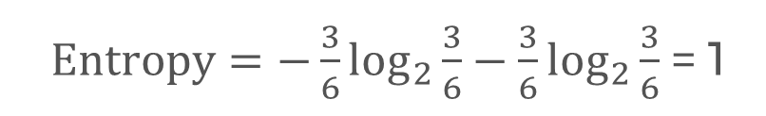
Entropy example
e.g. (3 yes / 3 no)
$Entropy=−\frac{3}{6}\log_{2}{\frac{3}{6}}−\frac{3}{6}\log_{2}{\frac{3}{6}}$ = 1

Slide 42
Entropy example
e.g. (3 yes / 3 no)
$Entropy=−\frac{3}{6}\log_{2}{\frac{3}{6}}−\frac{3}{6}\log_{2}{\frac{3}{6}}$ = 1
e.g. (4 yes / 0 no)

Slide 43
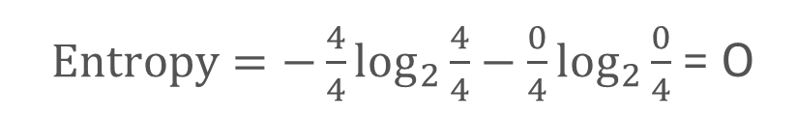
Entropy example
e.g. (3 yes / 3 no)
$Entropy=−\frac{3}{6}\log_{2}{\frac{3}{6}}−\frac{3}{6}\log_{2}{\frac{3}{6}}$ = 1
e.g. (4 yes / 0 no)
$Entropy=−\frac{4}{4}\log_{2}{\frac{4}{4}}−\frac{0}{4}\log_{2}{\frac{0}{4}}$ = 0

Slide 44
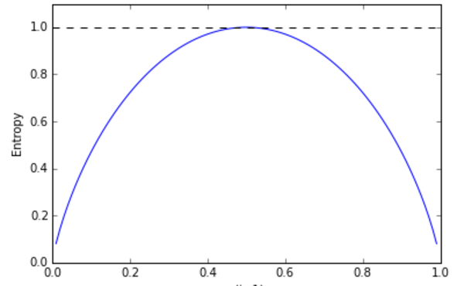
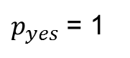
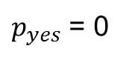
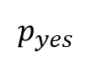
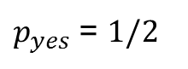
Entropy example
e.g. (3 yes / 3 no)
$Entropy=−\frac{3}{6}\log_{2}{\frac{3}{6}}−\frac{3}{6}\log_{2}{\frac{3}{6}}$ = 1
$p_{yes}$ = $1/2$
e.g. (4 yes / 0 no)
$Entropy=−\frac{4}{4}\log_{2}{\frac{4}{4}}−\frac{0}{4}\log_{2}{\frac{0}{4}}$ = 0
$p_{yes}$ = 0
$p_{yes}$ = 1
$$p_{yes}$$

Slide 45
Entropy example
exercise: (9 yes / 5 no)
$p_{yes}$ = $1/2$
$p_{yes}$ = 0
$p_{yes}$ = 1
$$p_{yes}$$

Slide 46
Entropy example
exercise: (9 yes / 5 no)
$p_{yes}$ = $1/2$
Answer: 0.940
$p_{yes}$ = 0
$p_{yes}$ = 1
$$p_{yes}$$

Slide 47
Entropy example
exercise: (9 yes / 5 no)
$p_{yes}$ = $1/2$
Answer: 0.940
exercise: (3 yes / 4 no)
$p_{yes}$ = 0
$p_{yes}$ = 1
$$p_{yes}$$

Slide 48
Entropy
Entropy tells us how pure one subset is.
But we want a measure of the effectiveness of an attribute in classifying the training data.
We actually want to aggregate info on different subsets.
Simply averaging the entropies don’t work. (Why not?)

Slide 49
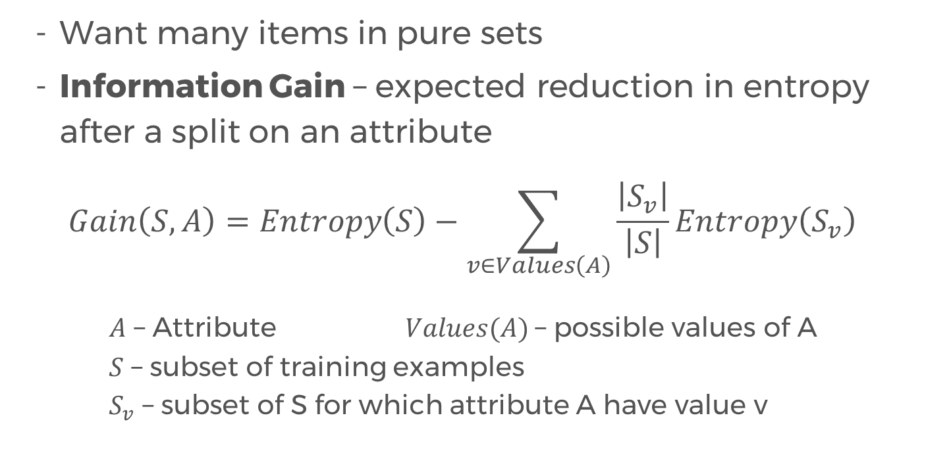
Information Gain
Want many items in pure sets
Information Gain – expected reduction in entropy after a split on an attribute
$$Gain\left(S,A\right)=Entropy\left(S\right)−\sum_{v∈Values\left(A\right)}{\frac{\left|S_{v}\right|}{\left|S\right|}Entropy\left(S_{v}\right)}$$
$A$ – Attribute $Values(A)$– possible values of A
$S$ – subset of training examples
$S_{v}$ – subset of S for which attribute A have value v

Slide 50
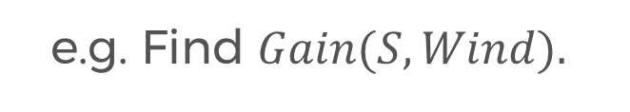
Information Gain
e.g. Find $Gain(S, Wind).$

Slide 51
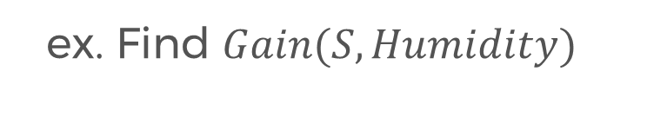
Information Gain
e.g. Find $Gain(S, Wind).$
Answer: 0.048
ex. Find $Gain(S, Humidity)$

Slide 52
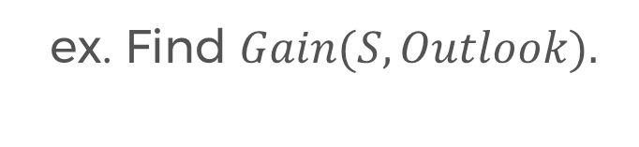
Information Gain
e.g. Find $Gain(S, Wind).$
Answer: 0.048
ex. Find $Gain(S, Humidity)$
Answer: 0.151
ex. Find $Gain(S, Outlook).$

Slide 53
Information Gain
e.g. Find $Gain(S, Wind).$
Answer: 0.048
ex. Find $Gain(S, Humidity)$
Answer: 0.151
ex. Find $Gain(S, Outlook).$
Answer: 0.246

Slide 54
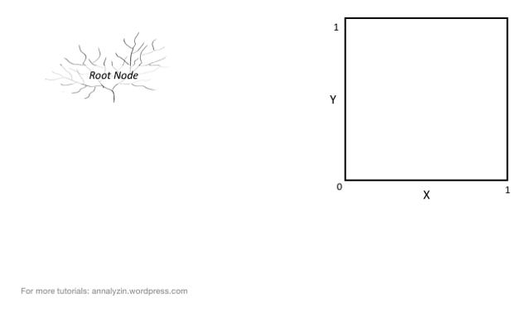
Splitting, visually

Slide 55
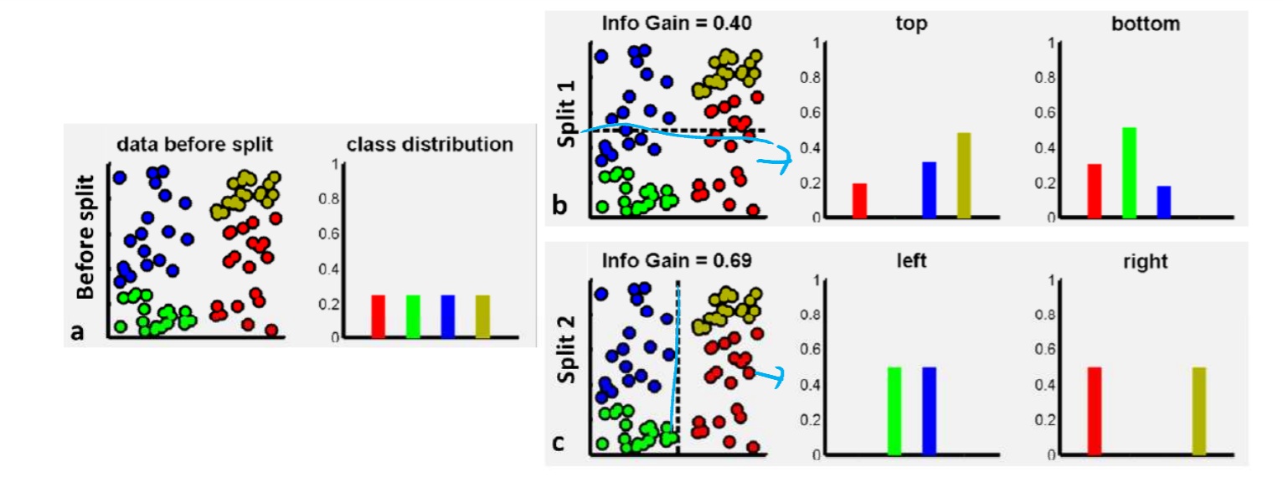
Information Gain, visually

Slide 56
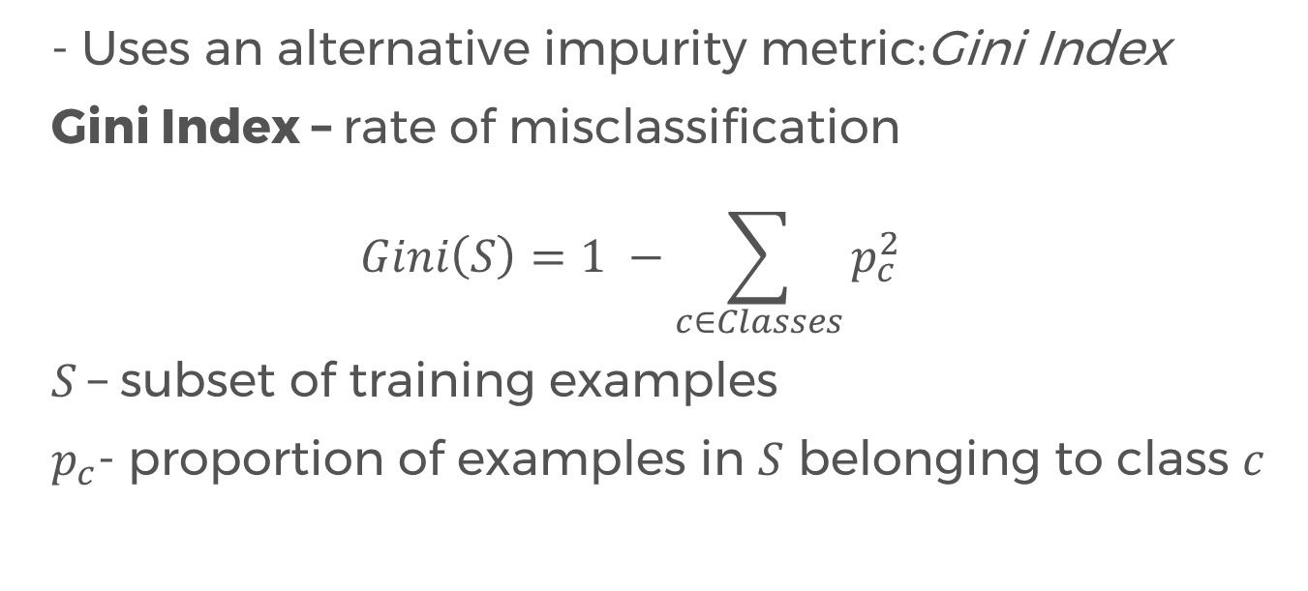
CART Algorithm (Briemanetal, 1984)
- Uses an alternative impurity metric:Gini Index
Gini Index – rate of misclassification
$$Gini\left(S\right)=1 −\sum_{c∈Classes}{p_{c}^{2}}$$
$S$– subset of training examples
$p_{c}$- proportion of examples in $S$ belonging to class $c$
Higher Gini index → more likely to misclassify

Slide 57
Gini Index example
e.g. (3 yes / 3 no)

Slide 58
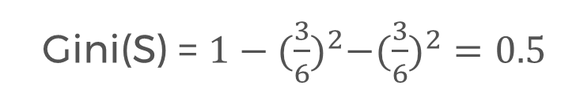
Gini Index example
e.g. (3 yes / 3 no)
Gini(S) = $1−{(\frac{3}{6})}^{2}−({\frac{3}{6})}^{2}=0.5$

Slide 59
Gini Index example
e.g. (3 yes / 3 no)
Gini(S) = $1−{(\frac{3}{6})}^{2}−({\frac{3}{6})}^{2}=0.5$
e.g. (4 yes / 0 no)

Slide 60

Gini Index example
e.g. (3 yes / 3 no)
Gini(S) = $1−{(\frac{3}{6})}^{2}−({\frac{3}{6})}^{2}=0.5$
e.g. (4 yes / 0 no)
Gini(S) = $1−{(\frac{4}{4})}^{2}−{(\frac{0}{4})}^{2}=0$

Slide 61







Gini Index example
e.g. (3 yes / 3 no)
Gini(S) = $1−{(\frac{3}{6})}^{2}−({\frac{3}{6})}^{2}=0.5$
$p_{yes}$ = $1/2$
e.g. (4 yes / 0 no)
Gini(S) = $1−{(\frac{4}{4})}^{2}−{(\frac{0}{4})}^{2}=0$
$p_{yes}$ = 0
$p_{yes}$ = 1
$$p_{yes}$$

Slide 62

Gini Index example

Slide 63

Information Gain
Information Gain – expected reduction in the misclassification rate after a split on an attribute
$$Gain\left(S,A\right)=Gini\left(S\right)−\sum_{v∈Values\left(A\right)}{\frac{\left|S_{v}\right|}{\left|S\right|}Gini\left(S_{v}\right)}$$
$A$ – Attribute $Values(A)$– possible values of A
$S$ – subset of training examples
$S_{v}$ – subset of S for which attribute A have value v

Slide 64
Entropy vs Gini Index
So which impurity measure should be used:
Entropy or Gini index?
Resulting trees are very similar in practice.
Best advice is that it is good practice when building decision tree models to
Try out different impurity metrics
Compare results to see which suits the dataset

Slide 65
EXERCISE OPTIONS
Solve by hand / calculator (takes a lot of time!)
Use python to to write function(s) that compute the entropy, gini index, and information gain.
- Make sure to handle log₂ 0.
Advanced: Write a program that builds a decision tree!
- Requires some knowledge on recursion, ADTs
Notes:
Please use only the three colors for the content.

Slide 66

Partner/Group/Individual Exercise
Predicting virus infection in files:
Notes:
Please use only the three colors for the content.

Slide 67
Challenge
Classify the type of vegetation that is likely to grow in areas of land based on descriptive feature.
ID | Stream | Slope | Elevation | Vegetation
1 | False | Steep | High | Chapparal
2 | True | Moderate | Low | Riparian
3 | True | Steep | Medium | Riparian
4 | False | Steep | Medium | Chapparal
5 | False | Flat | High | Conifer
6 | True | Steep | Highest | Conifer
7 | True | Steep | High | Chapparal
Notes:
No required

Slide 68
What type of vegetation would likely grow on terrain with a steep slope and medium elevation and is near a stream?
How about on terrain near a stream with high elevation, moderate slope?
Notes:
Please use only the three colors for the content.

Slide 69
Partner/Group/Individual Presentation
Notes:
Please use only the three colors for the content.

Slide 70
Next time
More on decision trees - pros and cons
Random Forests!

Slide 71
References
Decision Tree Lecture by Victor Lavrenko (Youtube)
Notes:
Please use only the three colors for the content.

Slide 72
T.I.L.
SHARE IT!
In front!
On Twitter: @wwcodemanila
Or FB: fb.com/wwcodemanila
Don’t forget to tag WWCodeManila so we can retweet or share it.
Notes:
Please use only the three colors for the content.

Slide 73
Feedback Form
https://goo.gl/YzSqcS
Please don’t rate the event on meetup.
Not helpful. It is best to just tell your concerns via the feedback form. We are a building a community not a Yelp restaurant.
Notes:
Please use only the three colors for the content.

Slide 74
THANK YOU :)
Notes:
Please use only the three colors for the content.

